Slide 1
Creating a Witness Slip
Unique Mickens
unique.mickens@ieanea.org

Slide 2
Purpose of a witness slip
A way to engage the general public and advocacy organizations in the legislative process
Provides legislators with data on view/position of a bill.
Integral step in getting legislation moving from committee to Senate/House floor

Slide 3
Positions and types of testimony
Positions
  Proponent
  Opponent
  No Position on Merits
Types of Testimony
  Oral
  Written
  Record of Appearance

Slide 4
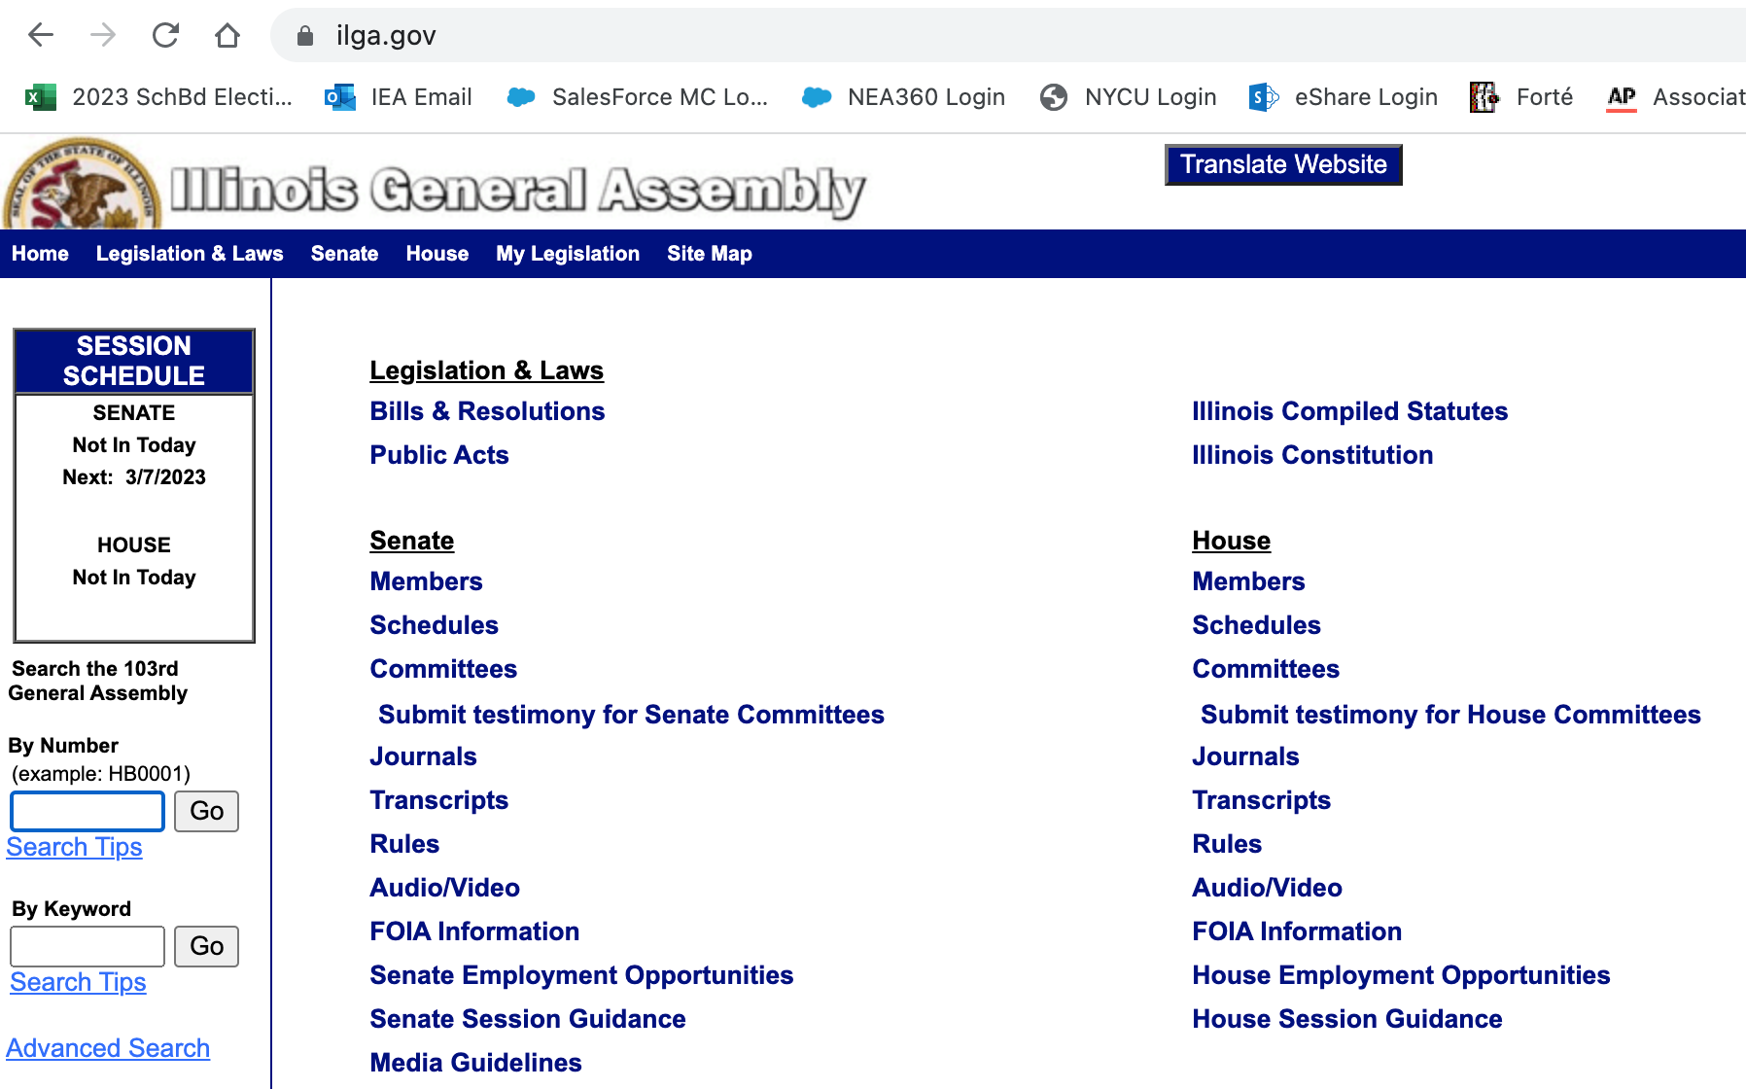
Step 1: Go to ilga.gov and click on the appropriate chamber’s schedule

Slide 5
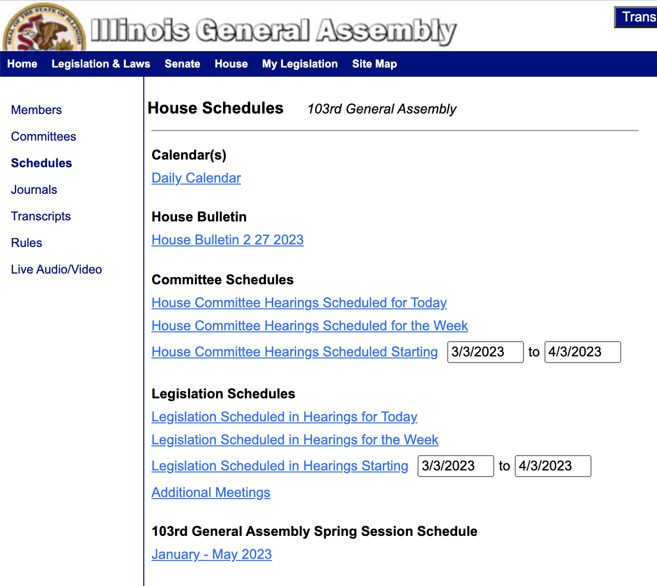
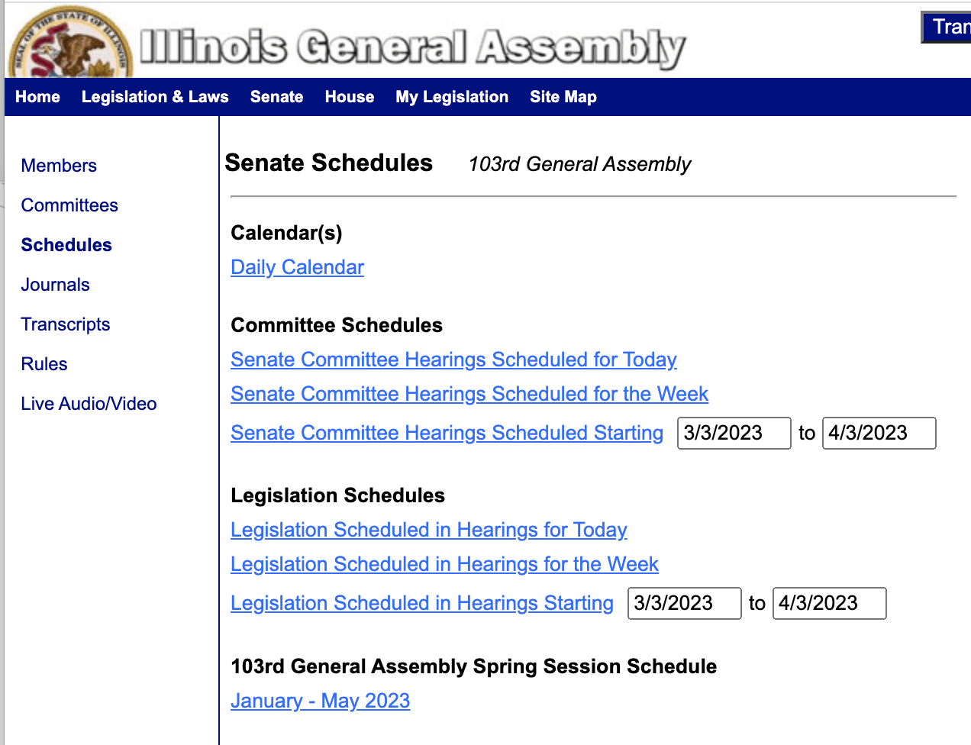
Step 2:
Click “schedule for the week” in the appropriate chamber

Slide 6
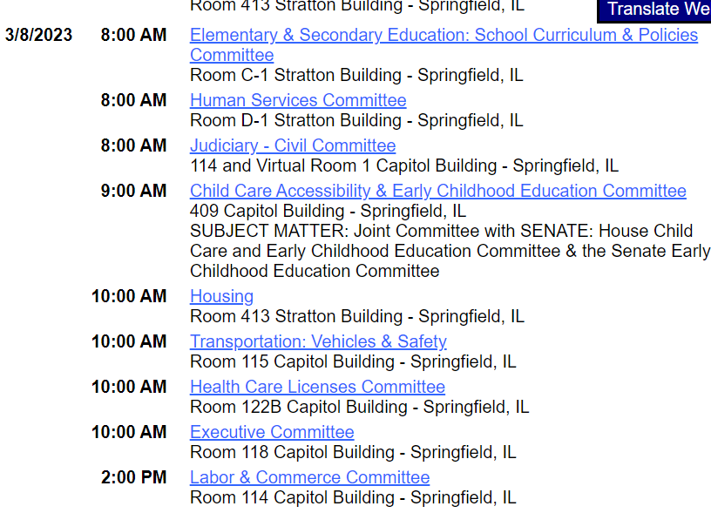
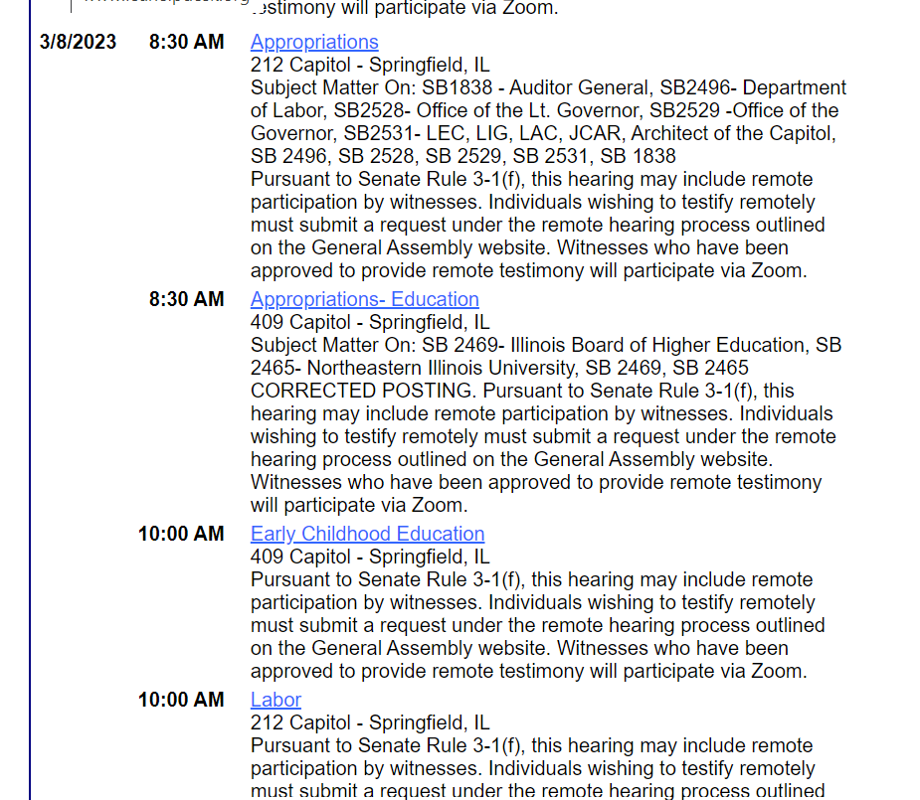
Step 3: Click on the committee that is hearing the bill
House committees
Senate committees

Slide 7
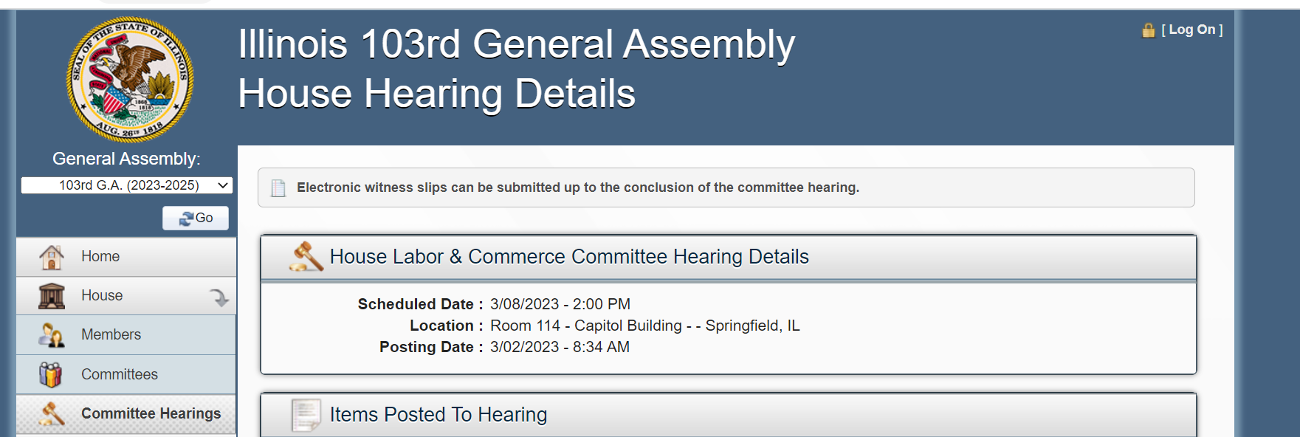
Step 4: Click on “create witness slip” and a new screen will appear

Slide 8
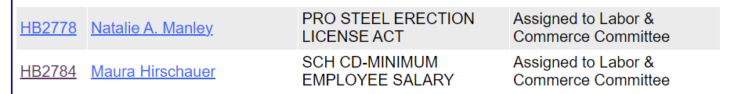
Step 5: Click on the paper with pencil

Slide 9
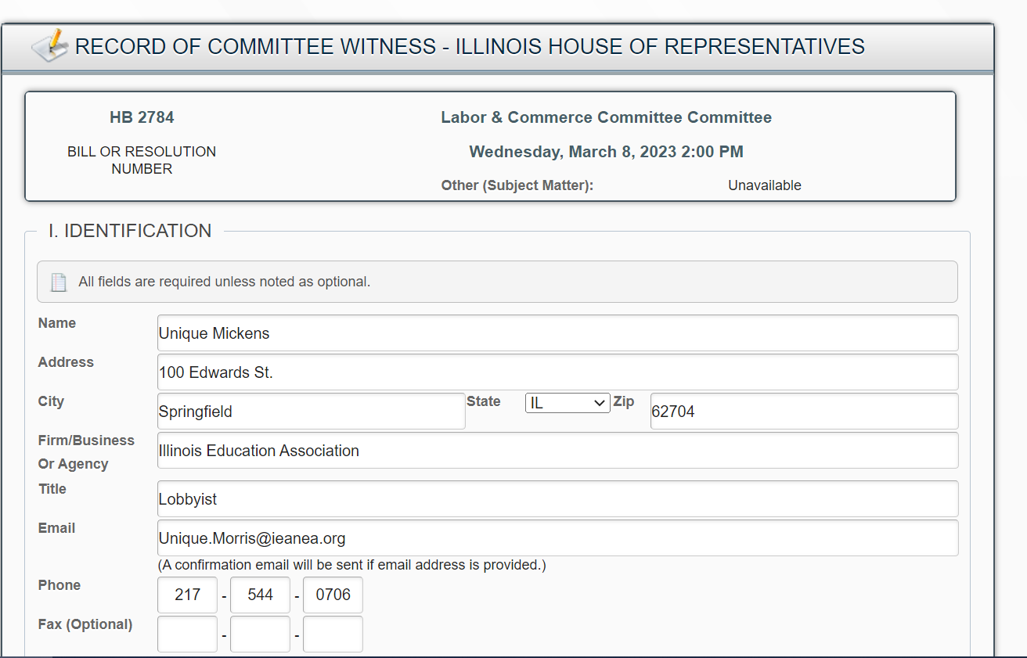
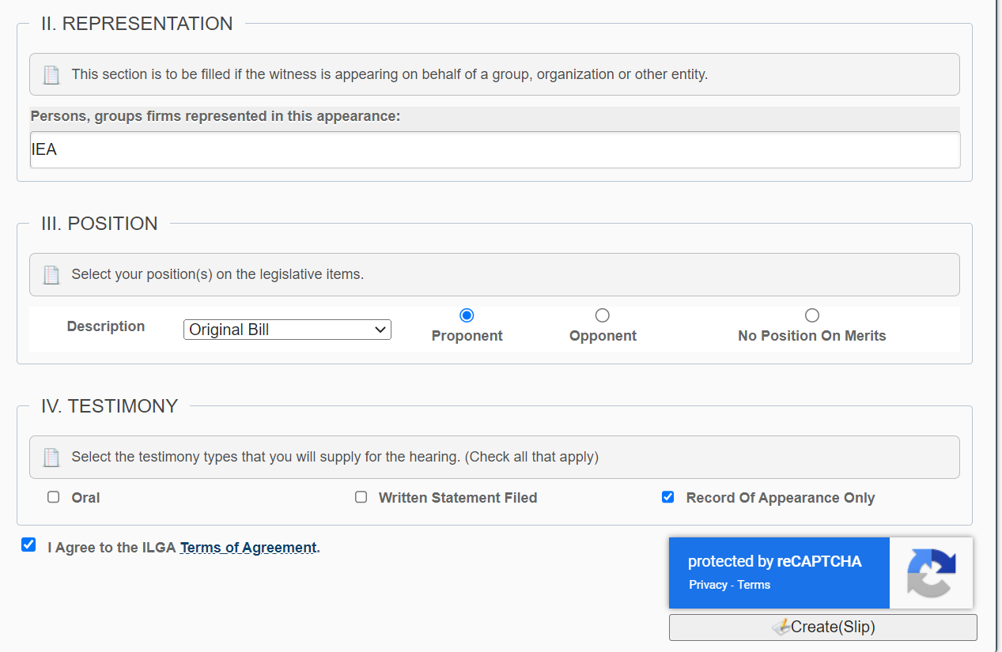
Step 6: Fill out slip with personal information , then click “create slip”

Slide 10
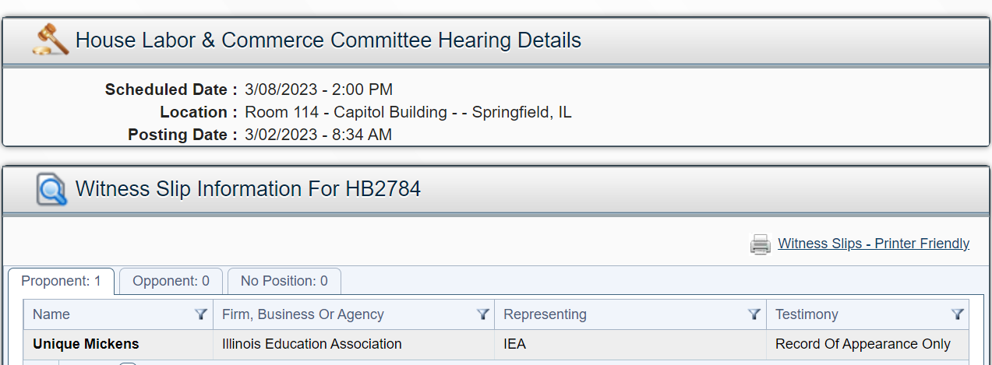
You’ve created a witness slip!!

Slide 11

Go and advocate!!

